Slide 1

WELCOME
COHORT 5
7th Sept – 3rd Dec 2026
Suite 6-6-7, Level 6, Menara MAA

Slide 2



Languages for Building Web Application
Build a web page structure
Add stylings to web page
Add dynamic behavior/interactivity
to web page
Notes:
How it works:
When you visit a website, your web browser (like Chrome, Firefox, Safari, Edge) downloads the HTML file for that page. The browser then reads the HTML code and renders it visually on your screen, displaying the text, images, and other elements according to the instructions given by the HTML tags.
It's important to note that HTML is primarily for structure and content. For styling (colors, fonts, layout) you use CSS (Cascading Style Sheets), and for interactivity (animations, dynamic content) you use JavaScript. Together, HTML, CSS, and JavaScript form the core technologies of the World Wide Web.

Slide 3
Introduction to HTML
What is a HTML File?
  HTML stands for Hyper Text Markup Language
  A HTML file is a text file containing small markup tags
  The markup tags tell the Web browser how to display the page
  A HTML file must have an htm or html file extension
  A HTML file can be created using a simple text editor and etc.

Slide 4
HTML Elements
  HTML tags are used to mark-up HTML elements
  HTML tags are surrounded by the two characters < and >
  The surrounding characters are called angle brackets
  HTML tags normally come in pairs like <b> and </b>
  The first tag in a pair is the start tag, the second tag is the end tag
  The text between the start and end tags is the element content
  HTML tags are not case sensitive, <b> means the same as <B>

Slide 5
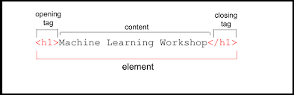
HTML Elements
Examples of HTML elements:
<b>This text is bold</b>
<body> This is my first homepage. <b>This text is bold</b>
</body>

Slide 6
Basic HTML Tags
<body> tag - Contains all visible content
Viewport meta tag - Makes your page mobile-friendly
Headings (<h1>, <h2>, <h3>, (<h4>, <h5>, <h6>) - Different sizes of titles
Paragraphs (<p>) - For text content
Unordered list (<ul> and <li>) - For bullet points
Link (<a>) - Links to external websites
Image (<img>) - A placeholder image

Slide 7
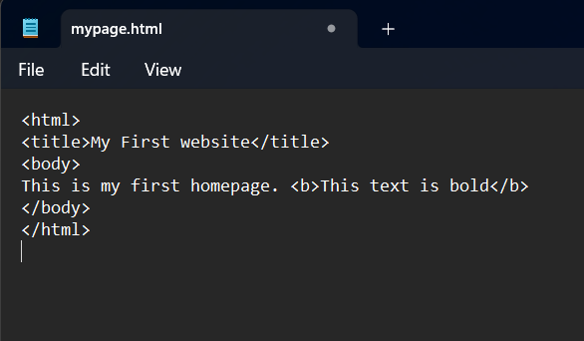
HTML using text editor (Hands On)
Open Notepad file and type in the following text:
Save the file as “mypage.html”

Slide 8
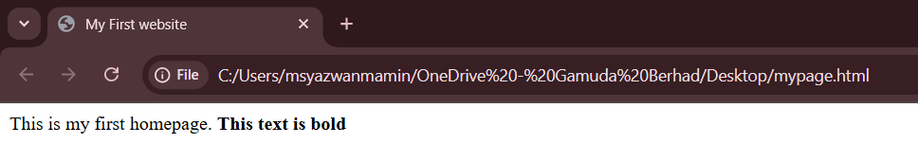
HTML using text editor (Hands On)
Start Internet browser, select “Open File” in the file menu.
Select "Browse" (or "Choose File") and locate the "mypage.html”
Select it and click "Open"

Slide 9
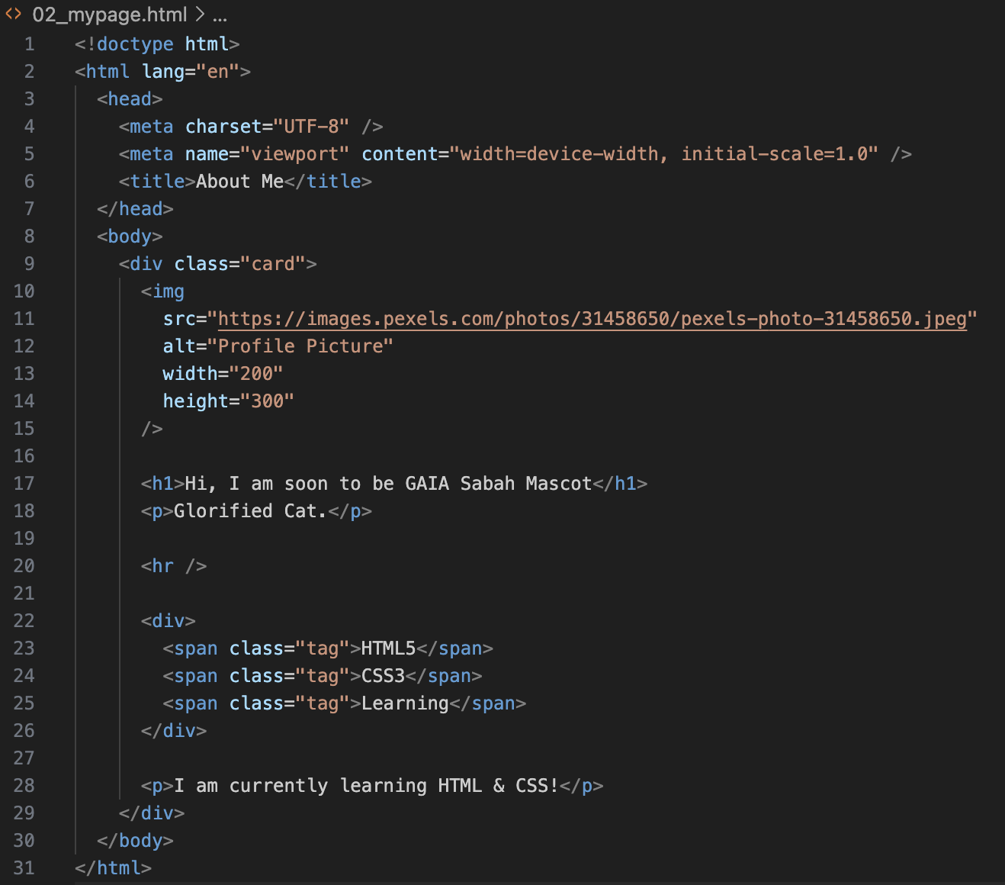
HTML via VScode

Slide 10
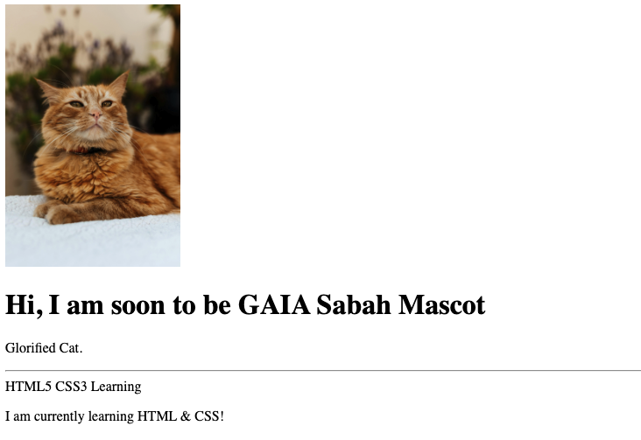
HTML via VScode

Slide 11
Languages for Building Web Application
Build a web page structure
Add stylings to web page
Add dynamic behavior/interactivity
to web page
Notes:
How it works:
When you visit a website, your web browser (like Chrome, Firefox, Safari, Edge) downloads the HTML file for that page. The browser then reads the HTML code and renders it visually on your screen, displaying the text, images, and other elements according to the instructions given by the HTML tags.
It's important to note that HTML is primarily for structure and content. For styling (colors, fonts, layout) you use CSS (Cascading Style Sheets), and for interactivity (animations, dynamic content) you use JavaScript. Together, HTML, CSS, and JavaScript form the core technologies of the World Wide Web.

Slide 12
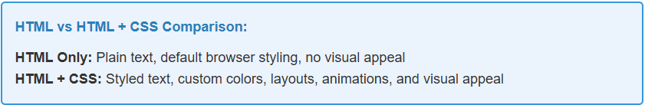
What is CSS?
  CSS stands for Cascading Style Sheets
  CSS is a stylesheet language used to describe the presentation of HTML documents.
  CSS controls how that content looks, while HTML provides structure and content.
  CSS makes website beautiful and functional.

Slide 13
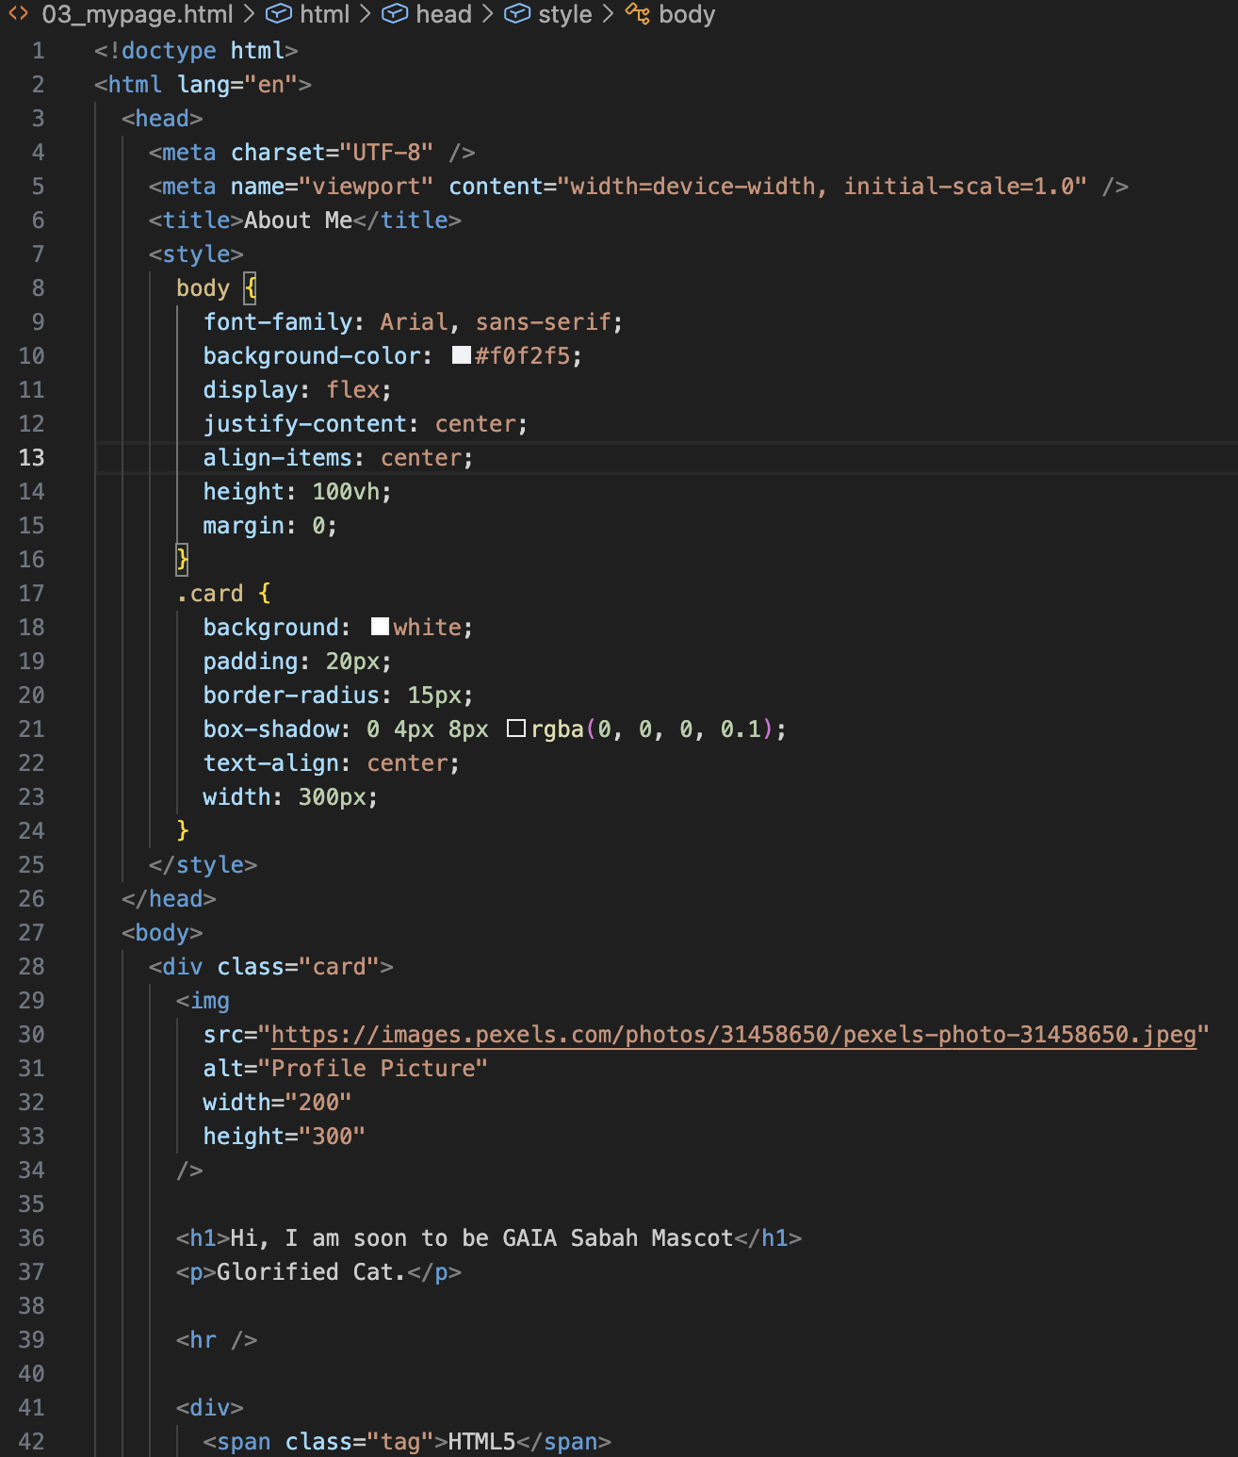
HTML & CSS

Slide 14

HTML & CSS

Slide 15
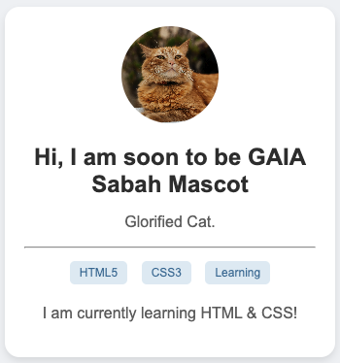
HTML & CSS
Notes:
body {
font-family: Arial, sans-serif;
background-color: #f0f2f5;
display: flex;
justify-content: center;
align-items: center;
height: 100vh;
margin: 0;
}
.card {
background: white;
padding: 20px;
border-radius: 15px;
box-shadow: 0 4px 8px rgba(0, 0, 0, 0.1);
text-align: center;
width: 300px;
}
img {
width: 100px;
height: 100px;
border-radius: 50%;
object-fit: cover;
}
h1 {
color: #333;
font-size: 24px;
}
p {
color: #666;
}
.tag {
display: inline-block;
background: #e1ecf4;
color: #39739d;
padding: 5px 10px;
border-radius: 5px;
font-size: 12px;
margin: 5px;
}

Slide 16
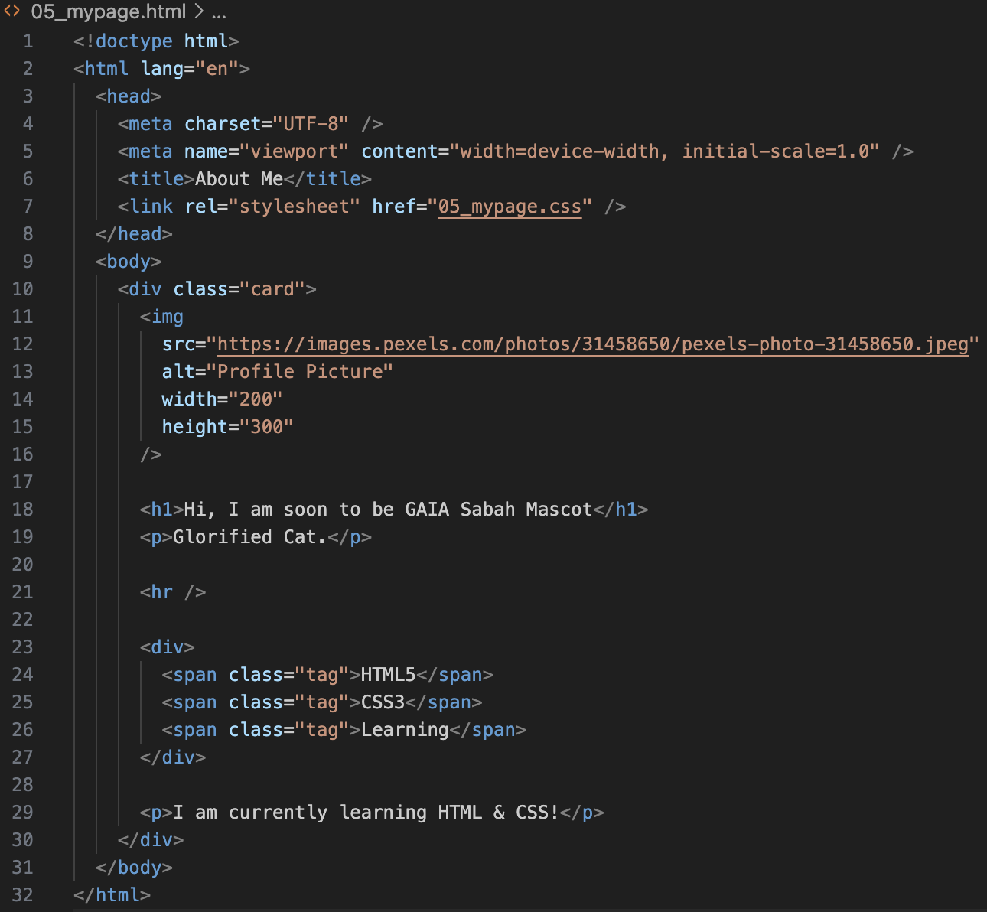
HTML & CSS File Structuring
Notes:
body {
font-family: Arial, sans-serif;
background-color: #f0f2f5;
display: flex;
justify-content: center;
align-items: center;
height: 100vh;
margin: 0;
}
.card {
background: white;
padding: 20px;
border-radius: 15px;
box-shadow: 0 4px 8px rgba(0, 0, 0, 0.1);
text-align: center;
width: 300px;
}
img {
width: 100px;
height: 100px;
border-radius: 50%;
object-fit: cover;
}
h1 {
color: #333;
font-size: 24px;
}
p {
color: #666;
}
.tag {
display: inline-block;
background: #e1ecf4;
color: #39739d;
padding: 5px 10px;
border-radius: 5px;
font-size: 12px;
margin: 5px;
}

Slide 17
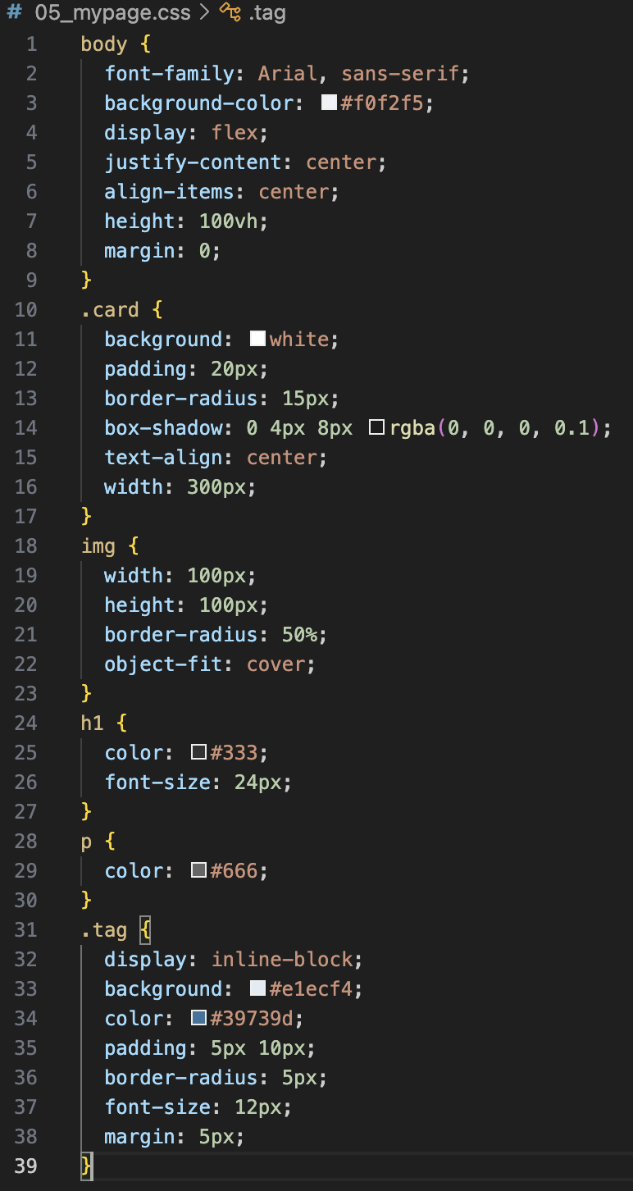
HTML & CSS File Structuring
Notes:
body {
font-family: Arial, sans-serif;
background-color: #f0f2f5;
display: flex;
justify-content: center;
align-items: center;
height: 100vh;
margin: 0;
}
.card {
background: white;
padding: 20px;
border-radius: 15px;
box-shadow: 0 4px 8px rgba(0, 0, 0, 0.1);
text-align: center;
width: 300px;
}
img {
width: 100px;
height: 100px;
border-radius: 50%;
object-fit: cover;
}
h1 {
color: #333;
font-size: 24px;
}
p {
color: #666;
}
.tag {
display: inline-block;
background: #e1ecf4;
color: #39739d;
padding: 5px 10px;
border-radius: 5px;
font-size: 12px;
margin: 5px;
}

Slide 18
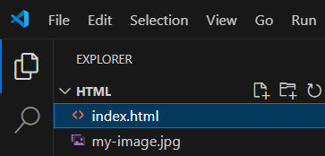
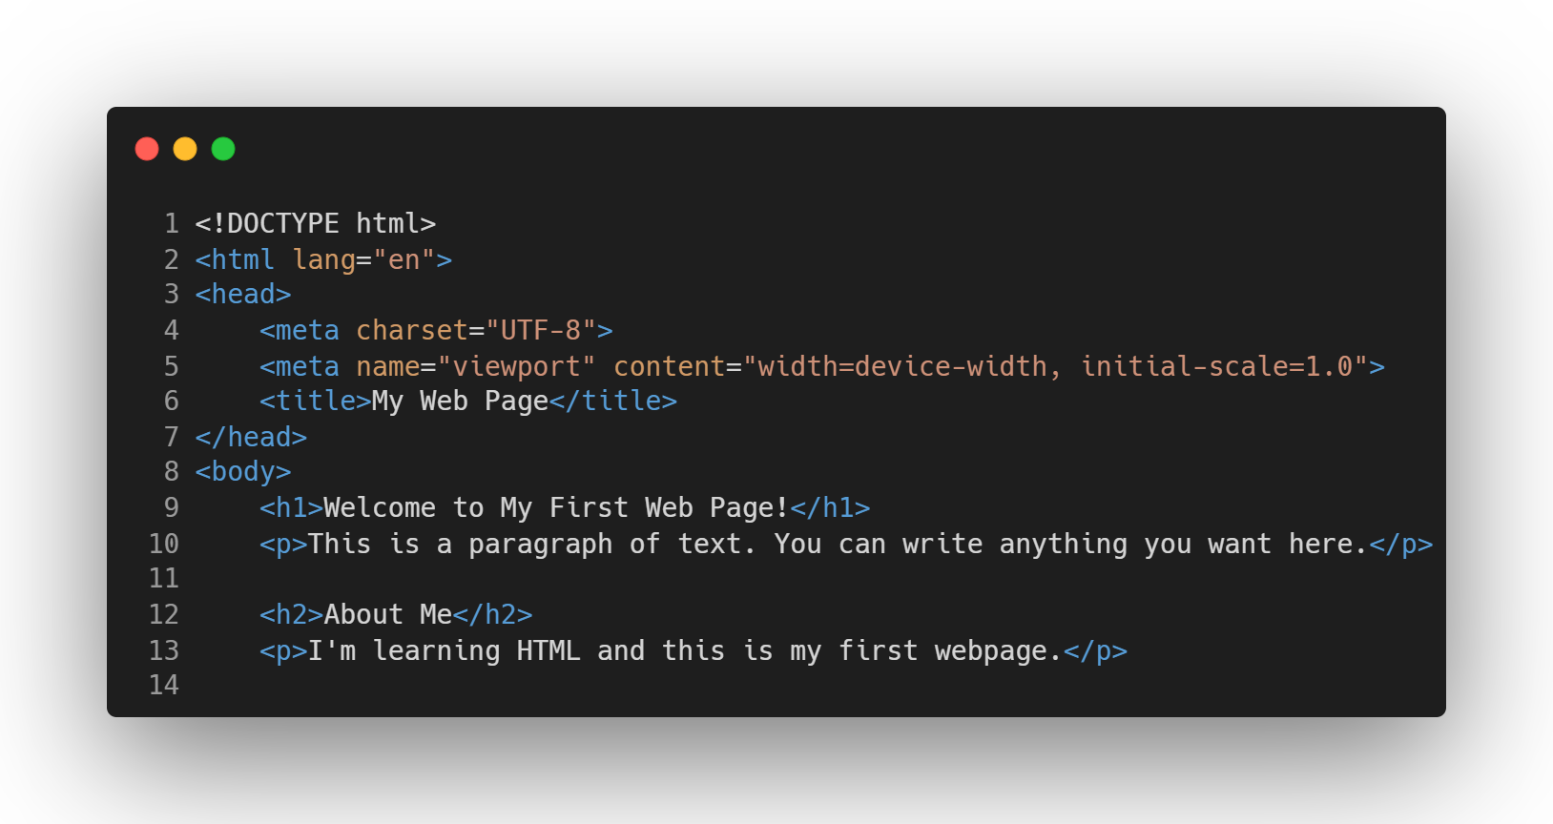
HTML Example
Create a file name “index.html”

Slide 19
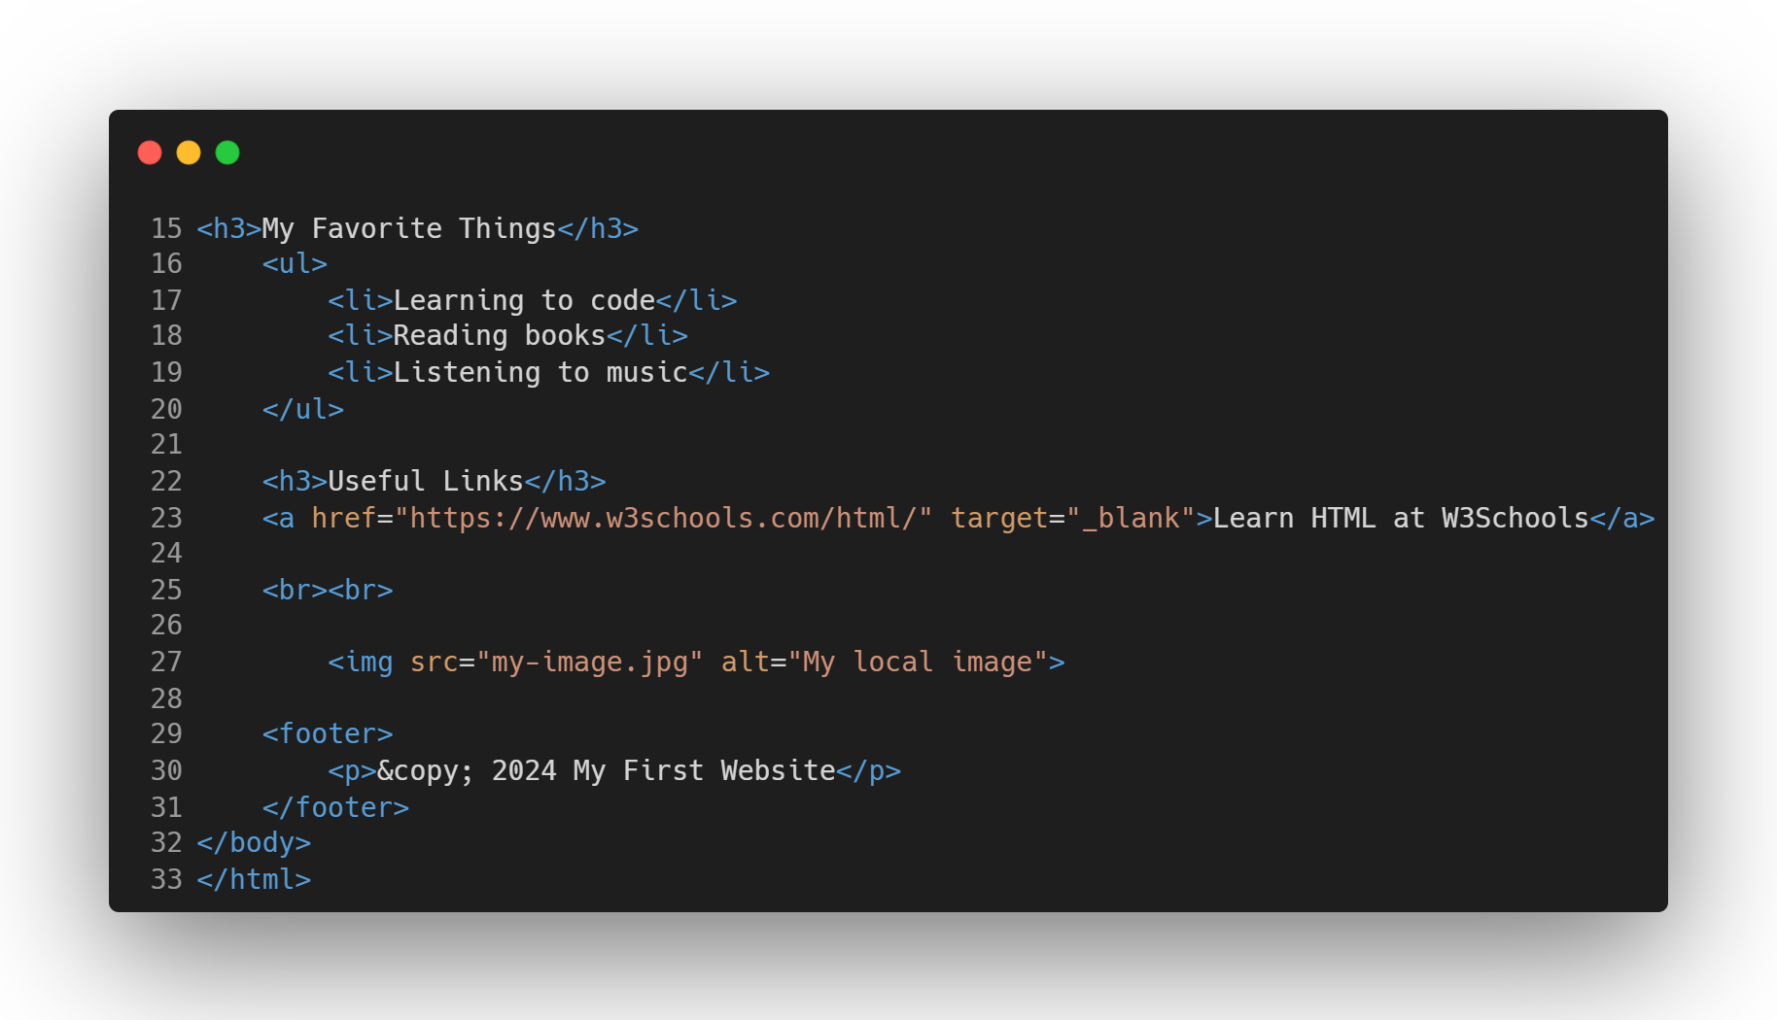
HTML Example
Create a file name “index.html”
Notes:
Essential HTML Document Structure:
<!DOCTYPE html>
<html lang="en">
<head>
<meta charset="UTF-8">
<meta name="viewport" content="width=device-width, initial-scale=1.0">
<title>Page Title</title>
</head>
<body>
<!-- Your content goes here -->
</body>
</html>
Explanation of Each Part:
<!DOCTYPE html>
Declares the document type and HTML version (HTML5)
<html>
Root element that contains all other elements
<head>
Contains metadata about the document (not visible on page)
<meta charset="UTF-8">
Specifies character encoding for the document
<meta name="viewport">
Controls how the page is displayed on mobile devices
<title>
Sets the title shown in browser tab
<body>
Contains all visible content of the webpage

Slide 20
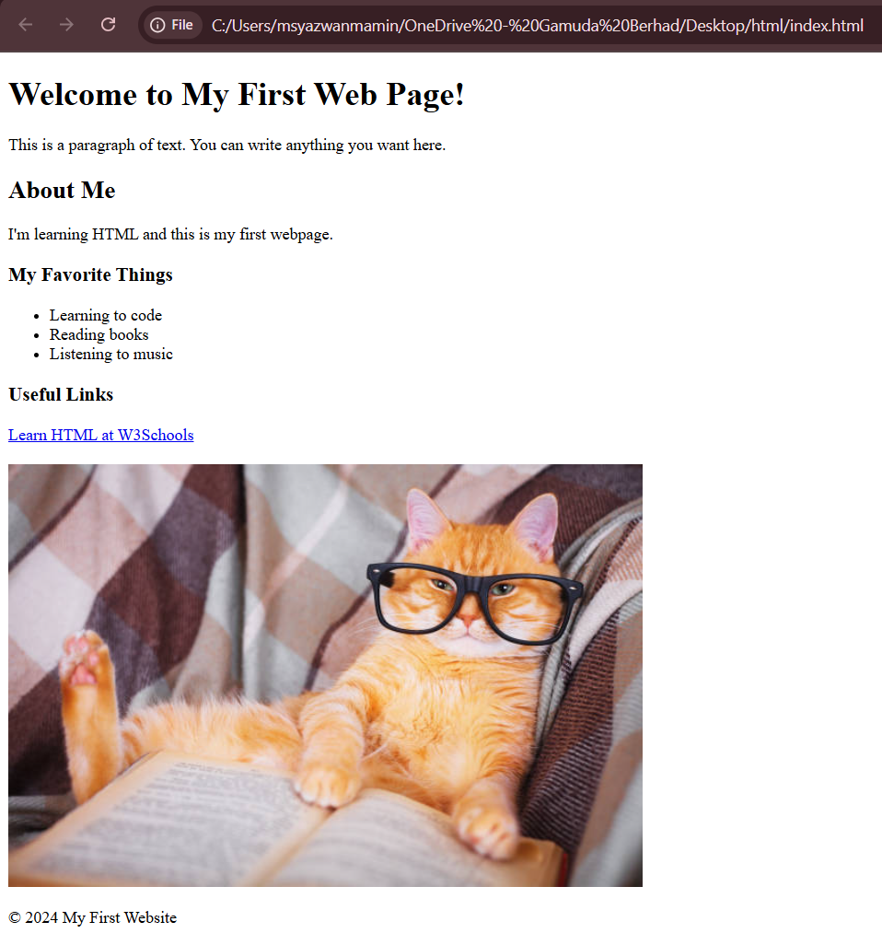
To open the file on browser:
Save this file as index.html in VS Code
Open it in your browser by double-clicking the file
Or use the Live Server extension in VS Code (to install)
You have just created
your first HTML webpage
Using VS Code!

Slide 21
Exercise
Based on the previous example, refine the style using CSS file method to make card-like look

Slide 22
HTML Extra Materials
  https://www.w3schools.com/html/default.asp

